Slide 1

Visual Basic .NET
Bryan Jenks
Integrated Ideas ©2005
A look into the .NET Programming Model

Slide 2

VB.NET Programming and the .NET Architecture
Planning and Designing for .NET
Object Oriented Programming Concepts
Advanced Programming Concepts
More Advanced Programming Concepts
Data Access Using ADO.NET
Testing and Debugging in .NET
The .NET Framework
Bryan Jenks - Integrated Ideas ©2005

Slide 3
VB.NET Programming and the .NET Architecture
Planning and Designing for .NET
  Programming Language Hierarchy
  The .NET Infrastructure
  .NET Project Types
  Designing for .NET
  Application Design Issues
Bryan Jenks - Integrated Ideas ©2005

Slide 4
Language Hierarchy
Machine Code
Assembly
Compiler
Un-managed Code
Runtime Engine (JIT)
Intermediate Language
Compiler
Managed Code
Bryan Jenks - Integrated Ideas ©2005

Slide 5
.NET Infrastructure
VB
C#
VJ#
Portable Executable
Application Manifest
MSIL
CLR
.NET Framework
Bryan Jenks - Integrated Ideas ©2005

Slide 6
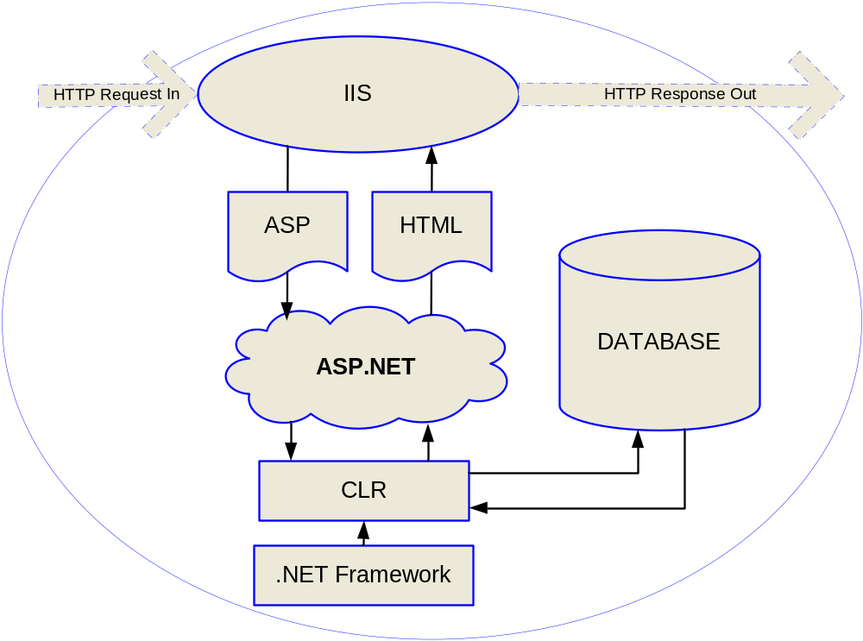
ASP.NET Architecture
Bryan Jenks - Integrated Ideas ©2005

Slide 7
.NET Projects
Windows Application
Web Application
Class Library
Windows Service
Web Service
Control Libraries
Setup and Deployment
Bryan Jenks - Integrated Ideas ©2005

Slide 8
Designing for .NET
Standalone Architecture
  Single PE
Three-Tier Architecture
  Presentation Tier
  Business Logic Tier
  Data Tier
N-Tier Architecture
  Web services
  Mobile Applications
Bryan Jenks - Integrated Ideas ©2005

Slide 9
Design Issues
Code Reuse
Scalability
Maintainability
Performance
Security
Durability
Integration and Interoperability
Bryan Jenks - Integrated Ideas ©2005

Slide 10
VB.NET Programming and the .NET Architecture
Planning and Designing for .NET
Object Oriented Programming Concepts
Advanced Programming Concepts
More Advanced Programming Concepts
Data Access Using ADO.NET
Testing and Debugging in .NET
The .NET Framework
Bryan Jenks - Integrated Ideas ©2005

Slide 11
VB.NET Programming and the .NET Architecture
Object Oriented Programming Concepts
  Object Oriented Programming
  Objects vs. Structures
  Methods, Events, and Properties
  Overloading
  Interfaces and Inheritance
Bryan Jenks - Integrated Ideas ©2005

Slide 12
Object Oriented Programming
Objects
Abstraction
Encapsulation
Polymorphism
Inheritance
Bryan Jenks - Integrated Ideas ©2005
Notes:
There are five requirements to OO languages.
Objects – provide data encapsulation, coupling and cohesion
Modular
Structured
Abstraction – facilitates parameterization (making something a function of something else)
Code Hiding
Encapsulation
Information Hiding
Cohesion
Polymorphism
Multiple Access Methods
Multiple Response Actions
Inheritance - facilitates polymorphism and encapsulation
Organization
Code-reuse

Slide 13
Object Components
The Object
Data
  Members
  Properties
Behavior
  Methods
  Events
Bryan Jenks - Integrated Ideas ©2005

Slide 14
Objects vs. Structures
Objects
  Members
  Properties
  Events
  Methods
  Instantiation
  Interfaces
  Inheritance
Structures
  Members
  Properties
  Methods
Bryan Jenks - Integrated Ideas ©2005

Slide 15
Objects vs. Structures
Public Structure Person
Public Appendages As Integer
Public Male As Boolean
Public EyeColor As Color
End Structure
Public Class Person
Public Appendages As Integer
Public Male As Boolean
Public EyeColor As Color
End Class
Bryan Jenks - Integrated Ideas ©2005

Slide 16
Methods
Public Class Person
Private Sub setBaby()
' Baby is born
End Sub
Private Function getBaby() As Person
' Baby is returned
Return New Person
End Function
End Class
Bryan Jenks - Integrated Ideas ©2005

Slide 17
Events
Public Class Person
Public Event Birth(ByVal Birtday As Date)
Private Sub getBaby()
' Baby is born
RaiseEvent Birth(Now)
End Sub
End Class
Bryan Jenks - Integrated Ideas ©2005

Slide 18
Properties
Public Class Person
Private myAppendages As Integer
Public Property Appendages() As Integer
Get
Return myAppendages
End Get
Set(ByVal value As Integer)
myAppendages = value
End Set
End Property
End Class
Bryan Jenks - Integrated Ideas ©2005

Slide 19
Overloading
Public Class Person
Private Sub Feed(Food as Integer)
' Person is fed food
End Sub
Private Sub Feed(Crap as Double)
' Person is fed crap
End Sub
End Class
Bryan Jenks - Integrated Ideas ©2005

Slide 20
Interfaces and Inheritance
Interfaces
  Enforces Design
  Ensures Compatibility
Inheritance
  Provides Coupling
  Enables Code Reuse
[demonstration]
Bryan Jenks - Integrated Ideas ©2005

Slide 21
VB.NET Programming and the .NET Architecture
Planning and Designing for .NET
Object Oriented Programming Concepts
Advanced Programming Concepts
More Advanced Programming Concepts
Data Access Using ADO.NET
Testing and Debugging in .NET
The .NET Framework
Bryan Jenks - Integrated Ideas ©2005

Slide 22
VB.NET Programming and the .NET Architecture
Advanced Programming Concepts
  Variables
    Scope
    Arrays
    Collections
  Object Passing and Optional Parameters
  Inheritance Control
    Overrides
    Shadows
Bryan Jenks - Integrated Ideas ©2005

Slide 23
Variable Scope
Dim
Protected (Module Level Access)
Private (Base Class Level Access)
Public (Project Level)
Friend (Assembly Level)
Static
Shared
Bryan Jenks - Integrated Ideas ©2005

Slide 24
Arrays and Collections
Array
Size
Item(Index)
Collection
Size
Item(Index)
Item(Key)
Add(Item)
Remove(Item)
Contains(Item)
[Array and collection demonstration]
Bryan Jenks - Integrated Ideas ©2005

Slide 25
Object Passing and Parameters
Object Passing
ByRef
ByVal
Optional Parameters
Keyword: Optional
= [Default Value]
Bryan Jenks - Integrated Ideas ©2005

Slide 26
Inheritance Control
Overrides
Replaces inherited member with permission
Shadows
Masks inherited member
[Inheritance Control demonstration]
Bryan Jenks - Integrated Ideas ©2005

Slide 27
VB.NET Programming and the .NET Architecture
Planning and Designing for .NET
Object Oriented Programming Concepts
Advanced Programming Concepts
More Advanced Programming Concepts
Data Access Using ADO.NET
Testing and Debugging in .NET
The .NET Framework
Bryan Jenks - Integrated Ideas ©2005

Slide 28
VB.NET Programming and the .NET Architecture
More Advanced Programming Concepts
  Threading
  Delegates
  Exception Handling
    Types of Errors
    Unstructured Handling
    Structured Handling
    Raising and Throwing Exceptions
Bryan Jenks - Integrated Ideas ©2005

Slide 29
Threading
Application Threading Concepts
The application thread
System.Threading Namespace
Thread.Kill, Sleep, Suspend
Threading Issues
  Dangling Threads
  Synchronization
  Thread Safety
Bryan Jenks - Integrated Ideas ©2005

Slide 30
Delegates
Process Flow Delegation
The Delegate Keyword
Delegate Declaration
The AddressOf keyword
Multicasting
  System.Delegate.Combine
Bryan Jenks - Integrated Ideas ©2005

Slide 31
Exception Handling
Types of Errors
Syntax Errors
Logic Errors
Runtime Errors
Bryan Jenks - Integrated Ideas ©2005

Slide 32
Unstructured Exception Handling
On Error Goto [location]
On Error Resume Next
Benefits
Easy to read
Simple to implement
Drawbacks
Difficult to troubleshoot
Poorly structured
Bryan Jenks - Integrated Ideas ©2005

Slide 33
Structured Exception Handling
The Err Object
Try, End Try
Catch
Finally
Benefits
Structured
Reliable
Drawbacks
Complicated
Requires Planning
Bryan Jenks - Integrated Ideas ©2005

Slide 34
Structured Exception Handling
Throwing Exceptions
The Exception Class
Throw [Exception]
Raising Errors
The error handling heirarchy
Err.Raise
Bryan Jenks - Integrated Ideas ©2005

Slide 35
VB.NET Programming and the .NET Architecture
Planning and Designing for .NET
Object Oriented Programming Concepts
Advanced Programming Concepts
More Advanced Programming Concepts
Data Access Using ADO.NET
Testing and Debugging in .NET
The .NET Framework
Bryan Jenks - Integrated Ideas ©2005

Slide 36
VB.NET Programming and the .NET Architecture
Data Access Using ADO.NET
  Database Concepts
  Data Connections
  Data Adaptors
  Datasets
  Data Readers
Bryan Jenks - Integrated Ideas ©2005

Slide 37
Database Concepts
Flat Databases
Text Files
DBF, DB4, DB5
COBOL
Relational Databases
MS Access
SQL Server
Oracle
Bryan Jenks - Integrated Ideas ©2005

Slide 38
Database Concepts
Database Components
Tables
Relations
Constraints
Users
Stored Procedures
User Defined Types
Catalogs
Bryan Jenks - Integrated Ideas ©2005

Slide 39
Data Access Components
Data Adaptors
Data Connections
Datasets
Data Readers
Bryan Jenks - Integrated Ideas ©2005

Slide 40
Data Connections
Data Connection Featues
Software Channel to Database
Propagates Authentication Criteria
Isolates Data Flow
Data Connection Types
OleDb
ODBC
SQLClient
Bryan Jenks - Integrated Ideas ©2005

Slide 41
Data Adaptors
Functions of the Data Adaptor
Understanding the Database
Maintaining Query Objects
Maintaining Query Parameters
Retrieving and Updating Data
Bryan Jenks - Integrated Ideas ©2005

Slide 42
Datasets
Dataset Components
DataTables
  DataColumns
  DataRows
Relations
Constraints
XML Interpolation
Bryan Jenks - Integrated Ideas ©2005

Slide 43
DataReaders
DataReader Features
Operates in Connected Architecture
Live Data Stream
Low memory overhead
Bryan Jenks - Integrated Ideas ©2005

Slide 44
VB.NET Programming and the .NET Architecture
Planning and Designing for .NET
Object Oriented Programming Concepts
Advanced Programming Concepts
More Advanced Programming Concepts
Data Access Using ADO.NET
Testing and Debugging in .NET
The .NET Framework
Bryan Jenks - Integrated Ideas ©2005

Slide 45
VB.NET Programming and the .NET Architecture
Testing and Debugging in .NET
  Breakpoints
  Stepping Through Code
    Step Into
    Step Over
    Step Out
  Debugging Windows
    Locals, Autos, and Watch
    Call Stack and Threads
    Immediate/Command
Bryan Jenks - Integrated Ideas ©2005

Slide 46
VB.NET Programming and the .NET Architecture
Planning and Designing for .NET
Object Oriented Programming Concepts
Advanced Programming Concepts
More Advanced Programming Concepts
Data Access Using ADO.NET
Testing and Debugging in .NET
The .NET Framework
Bryan Jenks - Integrated Ideas ©2005

Slide 47
VB.NET Programming and the .NET Architecture
The .NET Framework
  Microsoft
  System
    IO
    Text
    Windows
    Collections
    Net
    Security
    Threading
    Data
    Web
Bryan Jenks - Integrated Ideas ©2005

Slide 48
References
Designing VISUAL BASIC .NET Applications
David Vitter – CORIOLIS
MSDN Online
http://msdn.microsoft.com
Wikipedia - Object-oriented programming
http://en.wikipedia.org/wiki/Object-oriented_programming

